Slide 1


A* Search for Robot Navigation with Dynamic Costs
Optimal Path-finding in Warehouse Grids
Artificial Intelligence Lab
CSE 404
Presented By
Afsana Siddika
21201122
Presented To
Announcement: "10th week Task:- Lab Exam on Knowledge…"
Khaled Zinnurine
Assistent Teacher at UAP

Slide 2
Introduction
Formal Definition:
A* Search is an informed path finding algorithm that uses both actual cost from the start node and a heuristic estimate to the goal to find the most efficient path.
A* Search combines the strengths of:
Dijkstra’s Algorithm – guarantees the shortest path (optimal) but can be slow.
Greedy Best-First Search – explores quickly but may not find the best path.
By blending these two strategies, A* achieves a balance between speed and accuracy

Slide 3


Key Components of A* Algorithm
g(n):The actual cost from the start node to the current node.
h(n):The heuristic estimate of the cost from the current node to the goal.
f(n):The total estimated cost of the cheapest solution through the current node
f(n) = g(n) + h(n)
A* selects the node with the lowest f(n) to explore next, balancing the cost so far and the estimated cost to reach the goal.

Slide 4
Motivation
Traditional methods like BFS and DFS are inefficient in large spaces—BFS is slow and memory-heavy, while DFS may miss the shortest path.
Optimal & Efficient Path-finding A* reduces travel time and energy by always aiming for the shortest, most cost-effective route.
Smart Obstacle Avoidance Navigates around static and moving obstacles, ideal for dynamic and cluttered warehouse environments.
Terrain & Real-World Aware Factors in terrain costs (e.g., smooth vs. rough floors) and adapts in real-time for realistic, safe navigation.

Slide 5
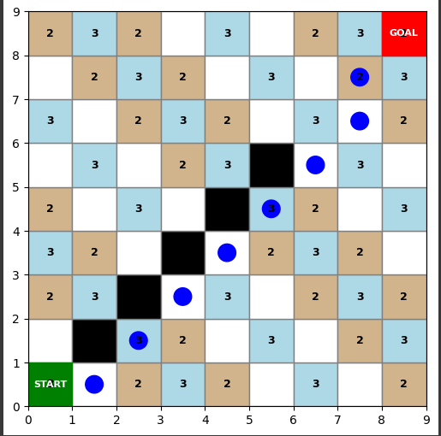
Path-finding Visualization
Grid Construction Rules :
Slippery (Cost=3): Cells where (x + y) % 3 == 0 (light blue).
Carpet (Cost=2): Cells where (x + y) % 2 == 0 (tan).
Normal Floor (Cost=1): All other cells (white).
Obstacles (Blocked): Manually specified in input (black).
A* finds the lowest-cost path from START (green) to GOAL (red).

Slide 6
Cost Rules:
Diagonal movement: 1.4 × terrain cost.
Cardinal movement: 1 × terrain cost.
Heuristic: Euclidean distance for efficient exploration.
Sample Output :
Start: (0, 0) Goal: (8, 8) Path Found: [(0, 0), (1, 0), (2, 1), (3, 2), (4, 3), (5, 4), (6, 5), (7, 6), (8, 7), (8, 8)] Total Cost: 23.8 Runtime: 0.000245s

Slide 7
Discussion and Conclusion :
Observations:
Optimal Path : The robot avoids obstacles and chooses the least-cost path.
Diagonal Movement : Used where beneficial (e.g., `(2,1)` → `(3,2)`).
Runtime : Very fast (`0.000245s`) due to heuristic-guided search.
The A* algorithm is highly effective for warehouse navigation, balancing optimality and speed.

Slide 8
Thank you

